Slide 1
Oracle cloud Infrastructure

Slide 2
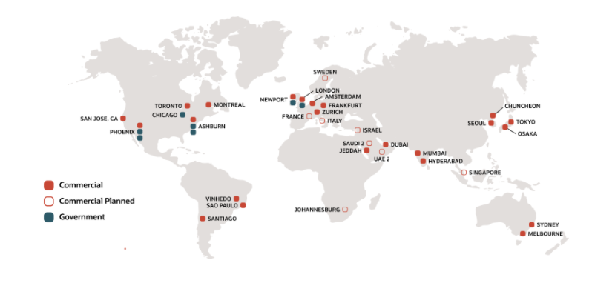
Regions in Oracle Cloud

Slide 3






OCI Architecture
Region
Available Domain 1
Available Domain 2
Available Domain 3
Fault Domain 1
Fault Domain 2
Fault Domain 3

Slide 4
Region and Availability Domain
A region is a localized geographic area, and an availability domain is one or more data centers located within a region.
Most Oracle Cloud Infrastructure resources are either region-specific, such as a virtual cloud network, or availability domain-specific, such as a compute instance
Fault Domains in Oracle Cloud Infrastructure (OCI)
A fault domain is a grouping of hardware and infrastructure within an availability domain. Each availability domain contains three fault domains. ... Protect against unexpected hardware failures. Protect against planned outages due to Compute hardware Maintenance.

Slide 5
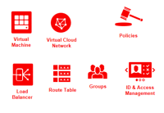
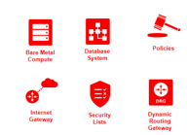
Compartment in Cloud:
Compartment is a logical container in which OCI resources reside. A resource in OCI will definitely belong to a Compartment. It is used to provide appropriate access to various resources in OCI. We can have sub-compartments in a compartment.
Tenancy (Root Compartment)
Compartment A
Compartment B

Slide 6
OCI Services
Identity and Access Management (IAM)
Networking
Compute
Storage

Slide 7
Identity and Access Management
Identity and Access Management (IAM) service enables you to control what type of access a group of users have and to which specific resources
Resource is a cloud object that you create and use in OCI (e.g. compute instances, block storage volumes, Virtual Cloud Networks)
Each OCI resource has a unique, Oracle-assigned identifier called an Oracle Cloud ID (OCID)
IAM uses traditional identity concepts such as Principals, Users, Groups, Authentication, Authorization and introduces a new capability called Compartment.

Slide 9
Networking:
VCN: A private network that you setup in oracle data center, with firewall rules and specific types of communication gateways that you can choose to use. It enables your resources such as compute instances to securely communicate with the internet with other instances running in Oracle Cloud Infrastructure or your on-premises data centers.
Subnet
Gateways
Route Tables
Security List
Network Security Group
Load Balancer: The Oracle Cloud Infrastructure Load Balancing service provides automated traffic distribution from one entry point to multiple servers reachable from your virtual cloud network (VCN).

Slide 10
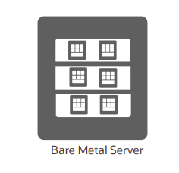
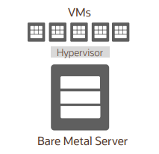
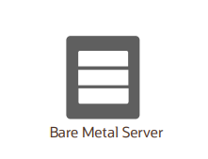
Compute:
Bare Metal (BM) Direct Hardware Access – customers get the full Bare Metal server (single-tenant model) | Virtual Machine (VM) A hypervisor to virtualize the underlying Bare Metal server into smaller VMs (multi-tenant model) | Dedicated VM Hosts (DVH) Run your VMs instances on dedicated servers that are a single tenant and not shared with other customers

Slide 11
Storage:
Block Volume: Block Volume Service lets you dynamically add storage capacity to an instance. You can create, attach, connect, and move volumes, as needed, to meet your storage and application requirements
Boot Volume: It is also kind of block volume where the operating system data is stored
File Storage: File Storage provides durable, scalable, secure, enterprise-grade network file systems that you can connect to from any bare metal, virtual machine, or container instance in your Virtual Cloud Network (VCN).
Object Storage: Any type of data, regardless of content type, is stored as an object. The object is composed of the object itself and metadata about the object. Each object is stored in a bucket

